Slide 1

IdentiPay
Secure Face-ID Fare Payment for Baku Metro
Pilot Proposal Presentation
Transforming public transportation through secure, contactless fare collection

Slide 2
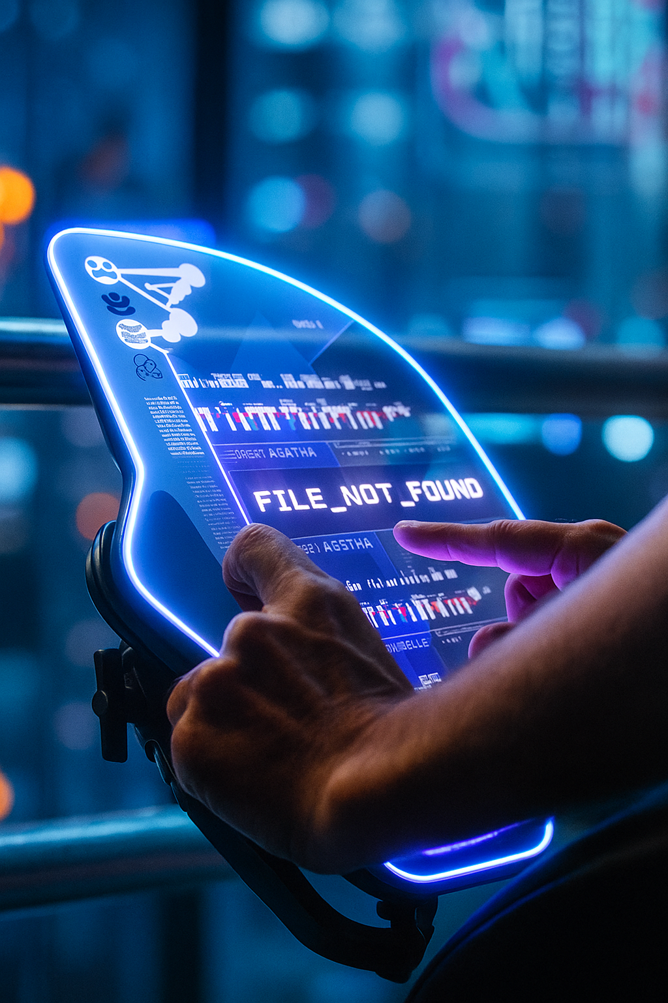
Executive Summary
Problem
Solution
Passenger congestion and fare collection inefficiencies mitigate system capacity and user experience
Face-ID recognition system enabling seamless check-in/out without physical cards or tickets
Impact
Faster boarding, reduced operational costs, and enhanced passenger satisfaction across the network
Movie: Minority Report, 2002

Slide 3

Current Passenger Challenges
Station Bottlenecks
Operational Impact
Long queues at turnstiles during peak hours
Reduced throughput capacity
Card malfunctions causing delays
Increased maintenance costs
Revenue leakage from fare evasion
Lost or forgotten fare cards
Tourist confusion with payment systems
Staff time managing payment issues
These friction points create cascading delays affecting the entire network's efficiency and passenger satisfaction.

Slide 4




Introducing IdentiPay
Instant Recognition
Sub-second face identification enables walk-through entry without stopping or fumbling for cards
Bank-Grade Security
Advanced encryption and non-reversible biometric embeddings protect passenger privacy
Mobile Integration
Simple enrollment through mobile app with automatic fare calculation and digital receipts

Slide 5





Seamless Passenger Journey
Enrollment
Quick 30-second registration via mobile app with identity verification
Entry Recognition
Walk through turnstile as cameras identify passenger and record entry
Travel
Enjoy journey while system calculates optimal fare based on actual route
Exit & Receipt
Automatic recognition at exit with instant digital receipt and payment

Slide 6

System Architecture Overview
Billing Integration
Camera Capture
Usage records
and invoicing
Turnstile-mounted video feeds
Biometric Database
Edge Inference Unit
Turnstile Vision System
for Paying System
Secure identity matching
Real-time face detection & inference
Backend APIs
Local Event Router
Authentication and event handling
Prepares events for transmission
The system leverages edge computing for real-time processing while maintaining secure cloud connectivity for billing and analytics. Distributed architecture ensures 99.9% uptime reliability.

Slide 7

Privacy & Security Excellence
Opt-in Consent
Voluntary enrollment with clear terms and easy withdrawal options
Non-Reversible Embeddings
Facial features converted to mathematical signatures that cannot reconstruct original images
End-to-End Encryption
All data transmission protected with military-grade encryption protocols
Data Minimization
30-day automatic deletion of transaction logs with no long-term storage of biometric data

Slide 8


